Slide 1
Spark SQL

Slide 2
Spark SQL
Spark introduces a programming module for structured data processing called Spark SQL.
It provides a programming abstraction called Data Frame and can act as distributed SQL query engine.

Slide 3
Features of Spark SQL
The following are the features of Spark SQL :
Integrated
Unified Data Access
Hive Compatibility
Standard Connectivity
Scalability

Slide 4
Integrated
Seamlessly mix SQL queries with Spark programs. Spark SQL lets you query structured data as a distributed dataset (RDD) in Spark, with integrated APIs in Python, Scala and Java. This tight integration makes it easy to run SQL queries alongside complex analytic algorithms.

Slide 5
Unified Data Access
Load and query data from a variety of sources. Schema-RDDs provide a single interface for efficiently working with structured data, including Apache Hive tables, parquet files and JSON files.

Slide 6
Hive Compatibility
Run unmodified Hive queries on existing warehouses. Spark SQL reuses the Hive frontend and MetaStore, giving you full compatibility with existing Hive data, queries, and UDFs. Simply install it alongside Hive.

Slide 7
Standard Connectivity
Connect through JDBC or ODBC. Spark SQL includes a server mode with industry standard JDBC and ODBC connectivity.

Slide 8
Scalability
Use the same engine for both interactive and long queries. Spark SQL takes advantage of the RDD model to support mid-query fault tolerance, letting it scale to large jobs too. Do not worry about using a different engine for historical data.

Slide 9
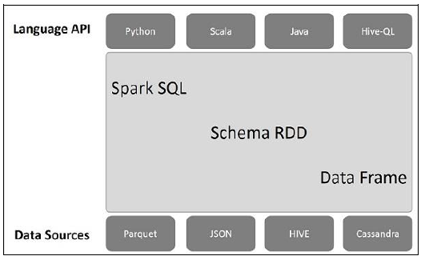
Spark SQL Architecture

Slide 10
Spark SQL Architecture
This architecture contains three layers namely, Language API, Schema RDD, and Data Sources.
Language API − Spark is compatible with different languages and Spark SQL. It is also, supported by these languages- API (python, scala, java, HiveQL).

Slide 11
Schema RDD − Spark Core is designed with special data structure called RDD. Generally, Spark SQL works on schemas, tables, and records. Therefore, we can use the Schema RDD as temporary table. We can call this Schema RDD as Data Frame.
Data Sources − Usually the Data source for spark-core is a text file, Avro file, etc. However, the Data Sources for Spark SQL is different. Those are Parquet file, JSON document, HIVE tables, and Cassandra database.

Slide 12
Introduction to Data Frame
Dataframe is a distributed collection of tabular data organized into rows and named columns.
It is conceptually equivalent to a table in a relational database.

Slide 13
Ways to create a dataframe
The most basic way is to transform another dataframe.
One can also create a dataframe from an RDD.
The next way is to create a dataframe from a local collection.
We can also create a dataframe using SQL as well.
Create a dataframe by reading the data from a source. Source can be csv file or json file etc…

Slide 14
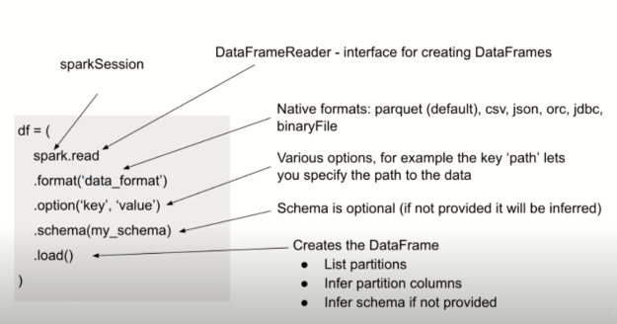
Syntax

Slide 15
Data Frame Operations
Dataframes are inspired from RDD in spark so whatever operations are supported by RDD, all those operations are also supported by data frames as well.
Data Frame Operations:
Transformation
Actions

Slide 16
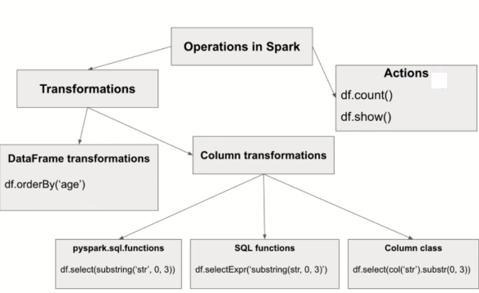
Operations

Slide 17
Methods to create Data Frame

Slide 18
Example
import spark.implicits._ --import package
val col = Seq(“team”, “matches”) --create data
val data = Seq((“India”, 300),(“Australia”, 280),(“England”,275))
Lets create RDD from the above data
val rdd = spark.sparkContext.parallelize(data)

Slide 19
Method1 toDF()
val df1 = rdd.toDF() -- convert rdd to dataframe
df1.show() -- show the data similar to take of rdd
This will give us the output in the form of rows and column but column names are not provided as we have not mentioned.
val df1 = rdd.toDF(“team”, “matches”)
df1.show() -- DF with col names

Slide 20
Method2 createDataFrame()
val df2 = spark.createDataFrame(rdd).toDF(col:_*)
Where rdd is input data and col is passed to toDF()
df2.show() will result into another dataframe.

Slide 21
Method 3 Create a DF using CSV File
val df3 = spark.read.csv(“file path”)
Example:
val df=spark.read.csv("C:/Users/Dell/Desktop/a.csv")
df3.show()
Note:
In order to create a data frame from a json file we will use .json instead of .csv in the above syntax. For text file we have to use .text

Slide 22
Running SQL Queries in Spark

Slide 23
SQL in Spark
SparkSQL is one of the most used Spark modules which is used for processing structured columnar data format.
Once you have a DataFrame created, you can interact with the data by using SQL syntax

Slide 24
Steps to Run SQL Queries
create sparksql session
Create a Data Frame from CSV
Convert CSV File into table
Use of SQL Queries.

Slide 25
create sparksql session
# Import SparkSession
import org.apache.spark.sql.SparkSession
Go to paste mode using :paste
# Create SparkSession
val spark = SparkSession.builder().master("local[1]")
.appName("SparkByExamples.com")
.getOrCreate()

Slide 26
Create a Data Frame from CSV
Execute below code in paste mode
val df = spark.read.option("header",true)
.csv(“D:/OneDrive/Desktop/a.csv")
df.printSchema()
df.show()

Slide 27
Convert CSV File into table using Views
Execute below code in paste mode
spark.read.option("header",true)
.csv(“D:/OneDrive/Desktop/a.csv")
.createOrReplaceTempView("Zipcodes")

Slide 28
Use of SQL Queries in Spark
Execute below code in paste mode
spark.sql("SELECT country, city, zipcode FROM ZIPCODES")
.show(5)
spark.sql(""" SELECT country, city, zipcode FROM ZIPCODES
WHERE country = 'US' """)
.show(5)

Slide 29
spark.sql(""" SELECT country, city, zipcode FROM ZIPCODES
WHERE country in ('IND') order by city """)
.show(5)
spark.sql(""" SELECT city, count(*) as count FROM ZIPCODES
GROUP BY city""")
.show()

Slide 30
Joins in Spark SQL

Slide 31
Joins
An SQL Join clause combine records from two or more tables. This operation is very common in data processing and understanding of what happens under the hood is important.
There are several common join types such as INNER, LEFT OUTER, RIGHT OUTER, FULL OUTER and CROSS or CARTESIAN JOINS.

Slide 32
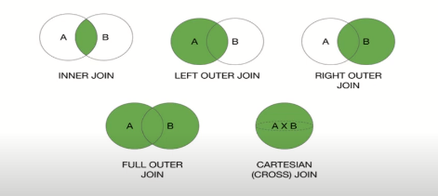
Joins in SQL

Slide 33
Joins supported by SparkSQL
Spark allows using following join types:
Inner
Outer
Left outer
Right outer
Left semi
Cross join

Slide 34
Example
Lets create first DF:
val emp1 = sc.parallelize(Array((10,”Inventory”,”Hybd”), (20,”Finance”,”bglr”), (30,”HR”,”Mumbai”), (40,”Admin”,”che”))).toDF(“Deptno”,”Dname”,”Loc”)
emp1.show()

Slide 35
Example (continues)
Lets create second table
val emp2 = sc.parallelize(Array((111,”Saketh”,”analyst”,444,10), (222,”Sudha”,”clerk”,333,20), (333,”Jagan”,”Manager”,111,10), (444,”madhu”,”engineer”,222,40))).toDF(“Empno”,”Ename”,”job”,”Mgr”,”DeptNo”)
emp2.show()

Slide 36
Inner Join
Inner join can be performed on two tables emp1 and emp2 using below code to get the common of both table:
emp1.join(emp2,”Deptno”).show()
OR
emp1.join(emp2,Seq(“Deptno”),”inner”).show()
Both the ways are for inner joins.

Slide 37
Left Outer join
It will display the content of left table along with common.
emp1.join(emp2,Seq(“Deptno”),”left_outer”).show()
This will display the inner join result along with extra content of left table.

Slide 38
Right Outer join
It will display the content of right table along with common.
emp1.join(emp2,Seq(“Deptno”),”right_outer”).show()
This will display the inner join result along with extra content of right table.

Slide 39
Full Outer Join
It will display the content of both the tables
emp1.join(emp2,Seq(“Deptno”),”full_outer”).show()
This will display the content of both emp1 and emp2.

Slide 40
Cross Join
Cross join is not recommended to use because of complexity over large tables.
emp1.crossJoin(emp2).show()
This join multiplies all the rows of one table with other table and shows unnecessary result

Slide 41
NOTE
All these previous join works with common column In both the tables.
If there isn’t any common column in any two tables then we cannot perform join on those tables using inner, outer or cross join. Hence we need to join these tables based on any condition.
In Self join a table will be joined to itself.

